Slide 1
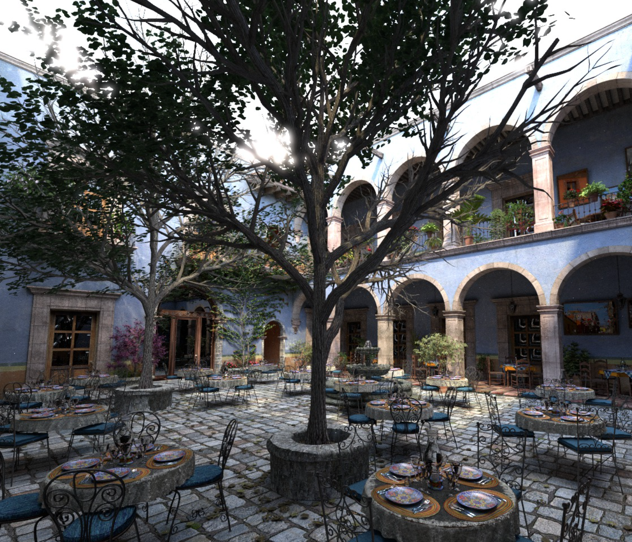
From Computer Graphics to Quantum Computing: finding the best paths
Luís Paulo Santos
01, July, 2022

Slide 2
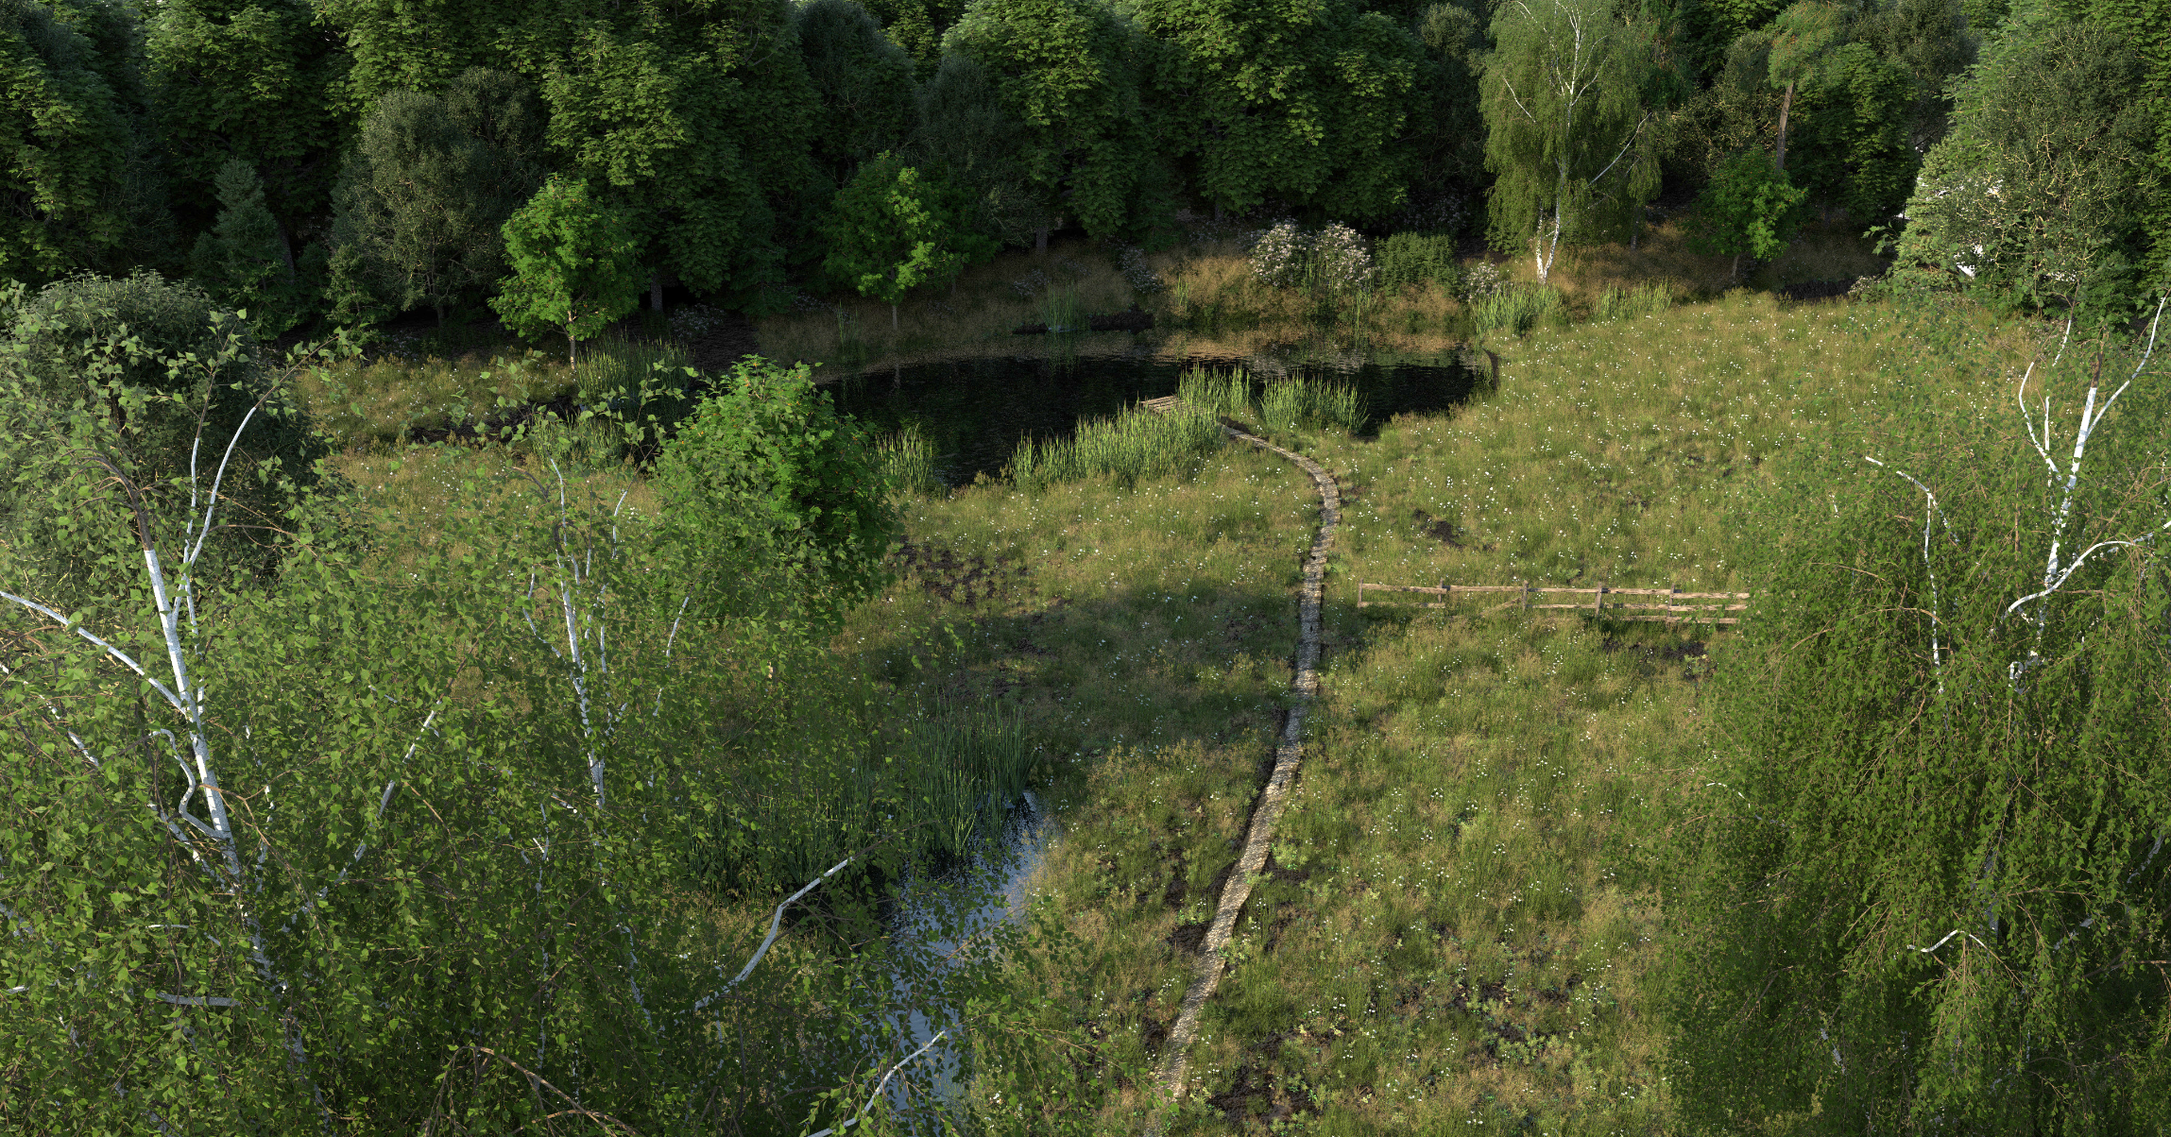
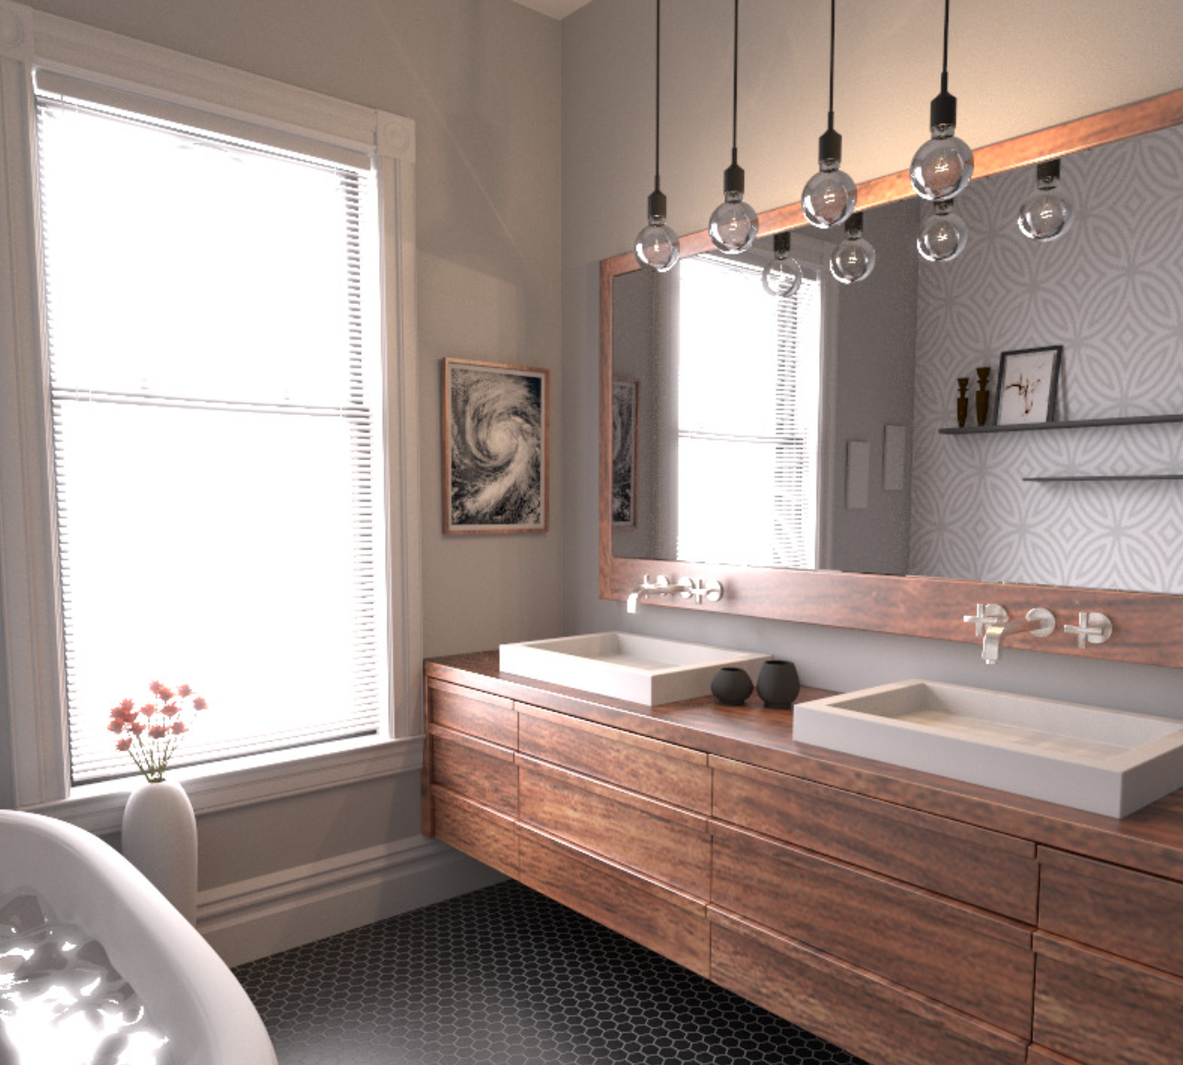

Slide 3
$$f\left(π_{0}\right)$$
$$π_{0}$$
$$π_{1}$$
$$I=\int_{Π}{f\left(π\right)dπ}$$
$$Π=\left\{π_{i}\right\},i=0…∞$$
$$\left\langle I\right\rangle =\frac{1}{N}\sum_{i=0}^{N−1}{\frac{f\left(π_{i}\right)}{p\left(π_{i}\right)}}$$
$${\left\langle I\right\rangle }_{0}=\frac{f\left(π\right)}{p\left(π\right)}$$

Slide 4
$$b_{0}$$
$$\left.\left|0\right.\right\rangle$$
H
S
H
T
$$\left.\left|ψ_{f}\right.\right\rangle$$
$$b_{1}$$
$$\left.\left|0\right.\right\rangle$$
X
S
X
T
$$b_{2}$$
$$\left.\left|0\right.\right\rangle$$
H
X
S
H
Layer 0
Layer 1
Layer 2
Layer 3
Space: $𝒪\left(2^{2n}\right)$
$$\left.\left|ψ_{f}\right.\right\rangle =U{\left.\left|0\right.\right\rangle }^{⊗n}$$
Time : $𝒪\left(2^{2n}\right)$

Slide 5
$$α_{π_{0},0}=1/2$$
$$α_{π_{0},1}=−1$$
$$α_{π_{0},2}=i/{\sqrt{2}}$$
$$α_{π_{0},3}=1/{\sqrt{2}}$$
$$\left.\left|000\right.\right\rangle$$
$$\left.\left|000\right.\right\rangle$$
$$\left.\left|000\right.\right\rangle$$
$$\left.\left|000\right.\right\rangle$$
$$\left.\left|000\right.\right\rangle$$
$$\left.\left|001\right.\right\rangle$$
$$\left.\left|001\right.\right\rangle$$
$$\left.\left|001\right.\right\rangle$$
$$\left.\left|001\right.\right\rangle$$
$$\left.\left|001\right.\right\rangle$$
$$\left.\left|010\right.\right\rangle$$
$$\left.\left|010\right.\right\rangle$$
$$\left.\left|010\right.\right\rangle$$
$$\left.\left|010\right.\right\rangle$$
$$\left.\left|010\right.\right\rangle$$
$$\left.\left|011\right.\right\rangle$$
$$\left.\left|011\right.\right\rangle$$
$$\left.\left|011\right.\right\rangle$$
$$\left.\left|011\right.\right\rangle$$
$$\left.\left|011\right.\right\rangle$$
$$\left.\left|100\right.\right\rangle$$
$$\left.\left|100\right.\right\rangle$$
$$\left.\left|100\right.\right\rangle$$
$$\left.\left|100\right.\right\rangle$$
$$\left.\left|100\right.\right\rangle$$
$$\left.\left|101\right.\right\rangle$$
$$\left.\left|101\right.\right\rangle$$
$$\left.\left|101\right.\right\rangle$$
$$\left.\left|101\right.\right\rangle$$
$$\left.\left|101\right.\right\rangle$$
$$\left.\left|110\right.\right\rangle$$
$$\left.\left|110\right.\right\rangle$$
$$\left.\left|110\right.\right\rangle$$
$$\left.\left|110\right.\right\rangle$$
$$\left.\left|110\right.\right\rangle$$
$$\left.\left|111\right.\right\rangle$$
$$\left.\left|111\right.\right\rangle$$
$$\left.\left|111\right.\right\rangle$$
$$\left.\left|111\right.\right\rangle$$
$$\left.\left|111\right.\right\rangle$$
$$f\left(π_{0}\right)=\prod_{j=0}^{L−1}{α_{π_{0},j}}=\frac{−i}{4}$$
H
S
H
T
X
S
X
T
H
X
S
H
$$\left\langle \left.0\right|U\left.\left|0\right.\right\rangle \right.$$

Slide 6
$$\left.\left|000\right.\right\rangle$$
$$\left.\left|000\right.\right\rangle$$
$$\left.\left|000\right.\right\rangle$$
$$\left.\left|000\right.\right\rangle$$
$$\left.\left|000\right.\right\rangle$$
$$\left.\left|001\right.\right\rangle$$
$$\left.\left|001\right.\right\rangle$$
$$\left.\left|001\right.\right\rangle$$
$$\left.\left|001\right.\right\rangle$$
$$\left.\left|001\right.\right\rangle$$
$$\left.\left|010\right.\right\rangle$$
$$\left.\left|010\right.\right\rangle$$
$$\left.\left|010\right.\right\rangle$$
$$\left.\left|010\right.\right\rangle$$
$$\left.\left|010\right.\right\rangle$$
$$\left.\left|011\right.\right\rangle$$
$$\left.\left|011\right.\right\rangle$$
$$\left.\left|011\right.\right\rangle$$
$$\left.\left|011\right.\right\rangle$$
$$\left.\left|011\right.\right\rangle$$
$$\left.\left|100\right.\right\rangle$$
$$\left.\left|100\right.\right\rangle$$
$$\left.\left|100\right.\right\rangle$$
$$\left.\left|100\right.\right\rangle$$
$$\left.\left|100\right.\right\rangle$$
$$\left.\left|101\right.\right\rangle$$
$$\left.\left|101\right.\right\rangle$$
$$\left.\left|101\right.\right\rangle$$
$$\left.\left|101\right.\right\rangle$$
$$\left.\left|101\right.\right\rangle$$
$$\left.\left|110\right.\right\rangle$$
$$\left.\left|110\right.\right\rangle$$
$$\left.\left|110\right.\right\rangle$$
$$\left.\left|110\right.\right\rangle$$
$$\left.\left|110\right.\right\rangle$$
$$\left.\left|111\right.\right\rangle$$
$$\left.\left|111\right.\right\rangle$$
$$\left.\left|111\right.\right\rangle$$
$$\left.\left|111\right.\right\rangle$$
$$\left.\left|111\right.\right\rangle$$
H
S
H
T
X
S
X
T
H
X
S
H
Space: $𝒪\left(1\right)$
$$\left\langle \left.0\right|\right.U\left.\left|0\right.\right\rangle =\sum_{j=0}^{2^{n(L−1)}}{f\left(π_{j}\right)}$$
$$≈\frac{1}{N}\sum_{j=0}^{N−1}{\frac{f\left(π_{j}\right)}{p\left(π_{j}\right)}}$$
?
Time : $𝒪\left(2^{n(L−1)}\right)$

Slide 7
$$\left.\left|000\right.\right\rangle$$
$$\left.\left|000\right.\right\rangle$$
$$\left.\left|000\right.\right\rangle$$
$$\left.\left|000\right.\right\rangle$$
$$\left.\left|000\right.\right\rangle$$
$$\left.\left|001\right.\right\rangle$$
$$\left.\left|001\right.\right\rangle$$
$$\left.\left|001\right.\right\rangle$$
$$\left.\left|001\right.\right\rangle$$
$$\left.\left|001\right.\right\rangle$$
$$\left.\left|010\right.\right\rangle$$
$$\left.\left|010\right.\right\rangle$$
$$\left.\left|010\right.\right\rangle$$
$$\left.\left|010\right.\right\rangle$$
$$\left.\left|010\right.\right\rangle$$
$$\left.\left|011\right.\right\rangle$$
$$\left.\left|011\right.\right\rangle$$
$$\left.\left|011\right.\right\rangle$$
$$\left.\left|011\right.\right\rangle$$
$$\left.\left|011\right.\right\rangle$$
$$\left.\left|100\right.\right\rangle$$
$$\left.\left|100\right.\right\rangle$$
$$\left.\left|100\right.\right\rangle$$
$$\left.\left|100\right.\right\rangle$$
$$\left.\left|100\right.\right\rangle$$
$$\left.\left|101\right.\right\rangle$$
$$\left.\left|101\right.\right\rangle$$
$$\left.\left|101\right.\right\rangle$$
$$\left.\left|101\right.\right\rangle$$
$$\left.\left|101\right.\right\rangle$$
$$\left.\left|110\right.\right\rangle$$
$$\left.\left|110\right.\right\rangle$$
$$\left.\left|110\right.\right\rangle$$
$$\left.\left|110\right.\right\rangle$$
$$\left.\left|110\right.\right\rangle$$
$$\left.\left|111\right.\right\rangle$$
$$\left.\left|111\right.\right\rangle$$
$$\left.\left|111\right.\right\rangle$$
$$\left.\left|111\right.\right\rangle$$
$$\left.\left|111\right.\right\rangle$$
H
S
H
T
X
S
X
T
H
X
S
H

Slide 8
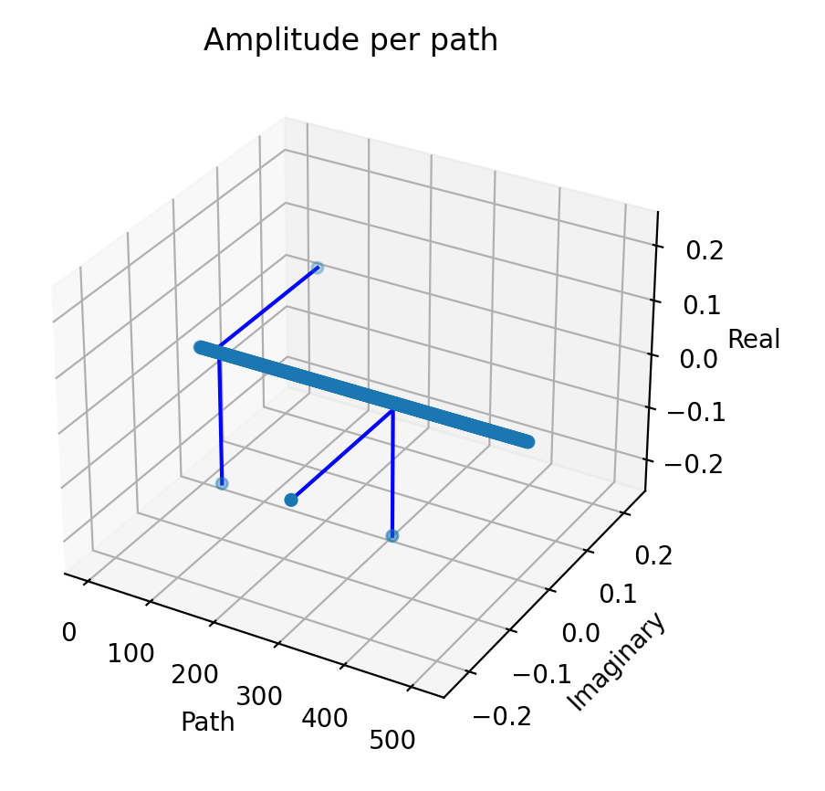
$$\left\langle \left.0\right|U\left.\left|0\right.\right\rangle =−0.5\right.$$
sparseness
numerical sign

Slide 9
$$π_{1}$$
$$π_{0}$$

Slide 10
$$\left.\left|000\right.\right\rangle$$
$$\left.\left|000\right.\right\rangle$$
$$\left.\left|000\right.\right\rangle$$
$$\left.\left|000\right.\right\rangle$$
$$\left.\left|000\right.\right\rangle$$
$$\left.\left|001\right.\right\rangle$$
$$\left.\left|001\right.\right\rangle$$
$$\left.\left|001\right.\right\rangle$$
$$\left.\left|001\right.\right\rangle$$
$$\left.\left|001\right.\right\rangle$$
$$\left.\left|010\right.\right\rangle$$
$$\left.\left|010\right.\right\rangle$$
$$\left.\left|010\right.\right\rangle$$
$$\left.\left|010\right.\right\rangle$$
$$\left.\left|010\right.\right\rangle$$
$$\left.\left|011\right.\right\rangle$$
$$\left.\left|011\right.\right\rangle$$
$$\left.\left|011\right.\right\rangle$$
$$\left.\left|011\right.\right\rangle$$
$$\left.\left|011\right.\right\rangle$$
$$\left.\left|100\right.\right\rangle$$
$$\left.\left|100\right.\right\rangle$$
$$\left.\left|100\right.\right\rangle$$
$$\left.\left|100\right.\right\rangle$$
$$\left.\left|100\right.\right\rangle$$
$$\left.\left|101\right.\right\rangle$$
$$\left.\left|101\right.\right\rangle$$
$$\left.\left|101\right.\right\rangle$$
$$\left.\left|101\right.\right\rangle$$
$$\left.\left|101\right.\right\rangle$$
$$\left.\left|110\right.\right\rangle$$
$$\left.\left|110\right.\right\rangle$$
$$\left.\left|110\right.\right\rangle$$
$$\left.\left|110\right.\right\rangle$$
$$\left.\left|110\right.\right\rangle$$
$$\left.\left|111\right.\right\rangle$$
$$\left.\left|111\right.\right\rangle$$
$$\left.\left|111\right.\right\rangle$$
$$\left.\left|111\right.\right\rangle$$
$$\left.\left|111\right.\right\rangle$$
H
S
H
T
X
S
X
T
H
X
S
H
$$\left\langle \left.0\right|U\left.\left|0\right.\right\rangle \right.$$

Slide 12
$$\left.\left|000\right.\right\rangle$$
$$\left.\left|000\right.\right\rangle$$
$$\left.\left|000\right.\right\rangle$$
$$\left.\left|000\right.\right\rangle$$
$$\left.\left|000\right.\right\rangle$$
$$\left.\left|001\right.\right\rangle$$
$$\left.\left|001\right.\right\rangle$$
$$\left.\left|001\right.\right\rangle$$
$$\left.\left|001\right.\right\rangle$$
$$\left.\left|001\right.\right\rangle$$
$$\left.\left|010\right.\right\rangle$$
$$\left.\left|010\right.\right\rangle$$
$$\left.\left|010\right.\right\rangle$$
$$\left.\left|010\right.\right\rangle$$
$$\left.\left|010\right.\right\rangle$$
$$\left.\left|011\right.\right\rangle$$
$$\left.\left|011\right.\right\rangle$$
$$\left.\left|011\right.\right\rangle$$
$$\left.\left|011\right.\right\rangle$$
$$\left.\left|011\right.\right\rangle$$
$$\left.\left|100\right.\right\rangle$$
$$\left.\left|100\right.\right\rangle$$
$$\left.\left|100\right.\right\rangle$$
$$\left.\left|100\right.\right\rangle$$
$$\left.\left|100\right.\right\rangle$$
$$\left.\left|101\right.\right\rangle$$
$$\left.\left|101\right.\right\rangle$$
$$\left.\left|101\right.\right\rangle$$
$$\left.\left|101\right.\right\rangle$$
$$\left.\left|101\right.\right\rangle$$
$$\left.\left|110\right.\right\rangle$$
$$\left.\left|110\right.\right\rangle$$
$$\left.\left|110\right.\right\rangle$$
$$\left.\left|110\right.\right\rangle$$
$$\left.\left|110\right.\right\rangle$$
$$\left.\left|111\right.\right\rangle$$
$$\left.\left|111\right.\right\rangle$$
$$\left.\left|111\right.\right\rangle$$
$$\left.\left|111\right.\right\rangle$$
$$\left.\left|111\right.\right\rangle$$
H
S
H
T
X
S
X
T
H
X
S
H
$$\left\langle \left.0\right|U\left.\left|0\right.\right\rangle \right.$$

Slide 13
From Computer Graphics to Quantum Computing: finding the best paths
Caminante, son tus huellas el camino y nada más; caminante, no hay camino, se hace camino al andar.
[Antonio Machado, “Proverbios y Cantares”, “Campos de Castilla”]

